Slide 1

Entrepreneurship for Engineers
Dr. Kalpana Ambepitiya

Slide 2
Introduction to Technopreneurship Session 02
Notes:
Change to 9th Edition and change title to Exploring Strategy. Update design

Slide 3
Chapter Objectives
Explain Technopreneurship and Technopreneurs .
Describe Knowledge-economy.
Discuss the meaning of Invention, Innovation and Creativity.
Identify the difference between Entrepreneurship and Technopreneurship.
Discuss the characteristics of Technopreneurs.

Slide 4
What is Technological Entrepreneurship?
It is simply entrepreneurship in a technology-intensive context
It is a process of merging technology prowess and entrepreneurial talent and skills
Technology + Entrepreneurship =
Technopreneurship

Slide 5
Technopreneurship
Technology entrepreneurs who develop an enterprise or business venture based on innovative technological products or services.
Describing an entrepreneur who uses cutting- edge technology to develop new business models
Someone who uses technology to do something new or invents new devices & then makes a business from selling these new things.

Slide 6
Therefore,
It is a socio-economic phenomenon which supports new economic growth in the k-based economy.
K-based economy – Knowledge-based economy
The knowledge economy is a system of consumption and production that is based on intellectual capital.
It refers to the ability to capitalize on scientific discoveries and basic and applied research.
This has come to represent a large component of all economic activity in most developed countries.
In a knowledge economy, a significant component of value may thus consist of intangible assets such as the value of its workers' knowledge or intellectual property.

Slide 7
The World Bank defines knowledge economies according to four pillars
1. Institutional structures that provide incentives for entrepreneurship and the use of knowledge.
2. Availability of skilled labor and a good education system.
3. Access to information and communication technology (ICT) infrastructures.
4. A vibrant innovation landscape that includes academia, the private sector, and civil society.

Slide 8
From Invention to Innovation to Commercialization
1. Invention
An invention is the creation of a new idea, process, product, or technology that did not exist before. It is the result of research, creativity, and experimentation.
Novel and original
Often involves technological breakthroughs
Requires research and development (R&D)
Can be protected through patents
Examples - The light bulb (Thomas Edison), The telephone (Alexander Graham Bell), The first electric car battery

Slide 9
From Invention to Innovation to Commercialization
2. Innovation
Innovation is improving, modifying, or applying an invention to solve real-world problems, create value, and achieve market success. It adds practical and commercial viability to an invention.
Can be an improvement of an existing product or process
Focuses on usability and market fit
Can be technological, business model, or process innovation
Often requires customer feedback and iterative development
Examples - Smartphones (An innovation based on the telephone), Electric cars (An innovation based on conventional vehicles), E-commerce platforms (An innovation using the internet for trade)

Slide 10
From Invention to Innovation to Commercialization
3. Commercialization
Commercialization is the process of bringing an invention or innovation to the market, making it available for customers, and generating revenue. It involves business development, funding, marketing, and scaling.
Turning an invention/innovation into a profitable business
Involves product development, branding, pricing, and sales
Requires funding, investment, and partnerships
Must consider market demand, scalability, and competition
Examples - Tesla commercializing electric cars, Apple commercializing touchscreen smartphones, Uber commercializing ride-sharing technology

Slide 11
From Invention to Innovation to Commercialization
The difference
Feature | Invention | Innovation | Commercialization
Definition | Creating something new | Improving and applying the invention for Market fit | Bringing the innovation to market
Focus | Discovery & Research | Practical application & usability | Business, sales & profit
Example | Light bulb | LED light bulbs | Selling LED bulbs worldwide
Risk | High (may not work) | Moderate (market validation needed) | Business risk (competition, market demand)
Requires | Creativity, R&D, patents | Iteration, customer feedback, business model | Marketing, funding, scaling

Slide 12





Why Engineering Innovations Fail
Funding Constraints
Poor Business Model
Inability to secure sufficient capital to support growth.
Challenges
Unsustainable revenue generation and cost structure.
Technical difficulties, regulatory hurdles, and unforeseen obstacles.
IP Issues
Lack of Market Demand
Insufficient protection for invention or lack of proper enforcement.
No market for your product or service.
3
2
4
1
5

Slide 13
Entrepreneurship
Creating the “New” and destroying the “Old”
New knowledge
New products
New processes
New services
New markets
New business models
New raw materials

Slide 14
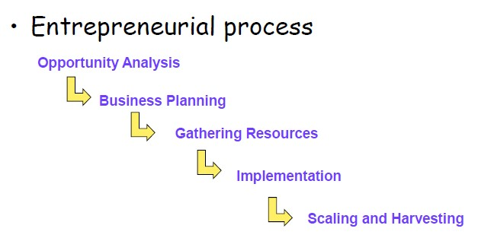
Entrepreneurial process vs. Technopreneurial process

Slide 15
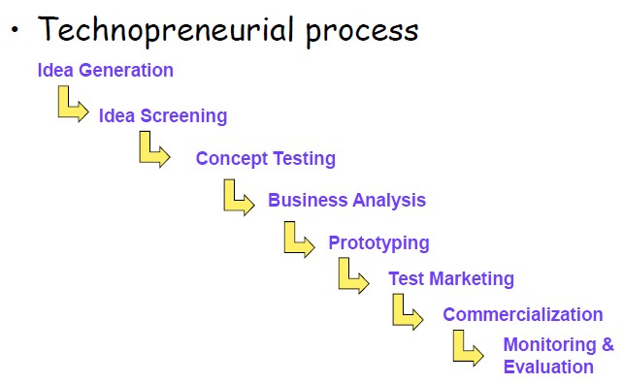
Entrepreneurial process vs. Technopreneurial process

Slide 16
Characteristics of Technopreneurs
Innovation
Risk-taking
Opportunity seeking
Management
Profit orientation
Visionary
Creative
Practicability
Leadership
Rational
Set own standards
Flexible
Hard working
Self-confidence
Persistent
Initiative
Committed
Reliable
Build strengths
Integrity

Slide 17
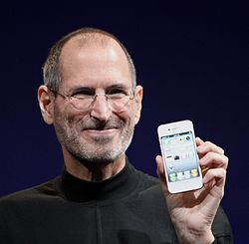
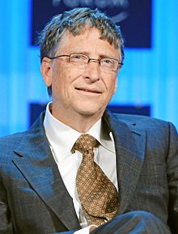
Who Has Been?
Steve Jobs
Bill Gates

Slide 18
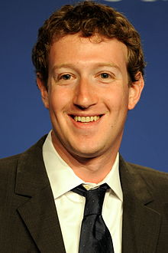
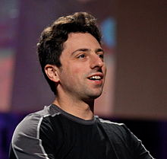

Who has Been…..?
Mark Zuckerberg
Sergey Brin and Larry Page

Slide 19
Classroom Group activity
Pick any technopreneur and do a 5 minutes presentation on what motives he had to become an entrepreneur.

Slide 20
The End

